Slide 1

Clean Code Principles
Cochior-Heghi Lucian

Slide 2
Agenda:
-Clean code
-Solid Principles
-Other Principles
-Design Patterns

Slide 3

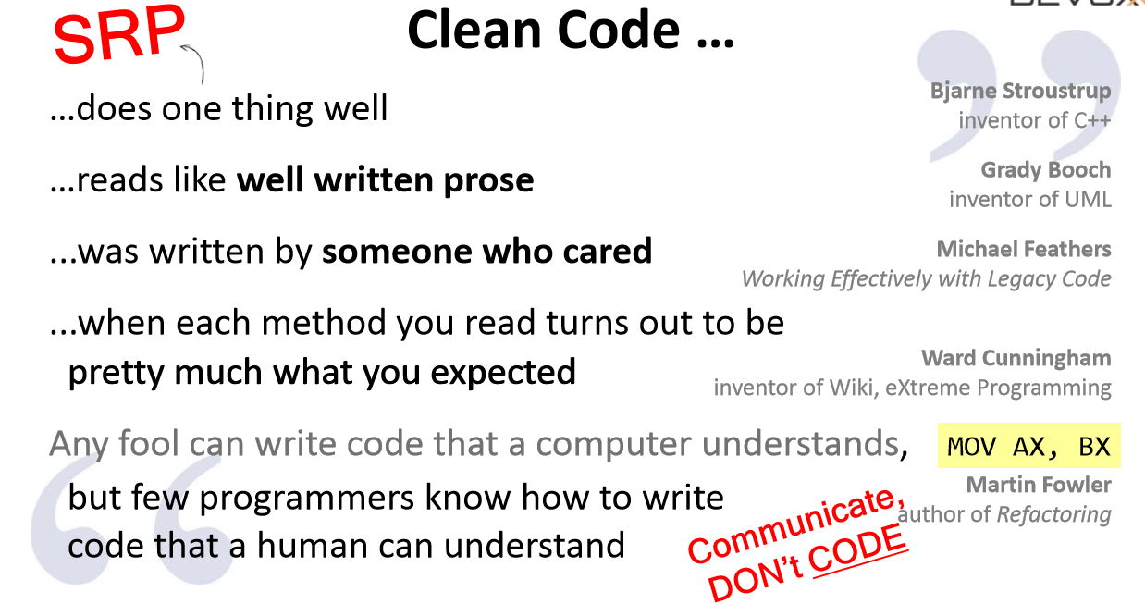

Slide 4
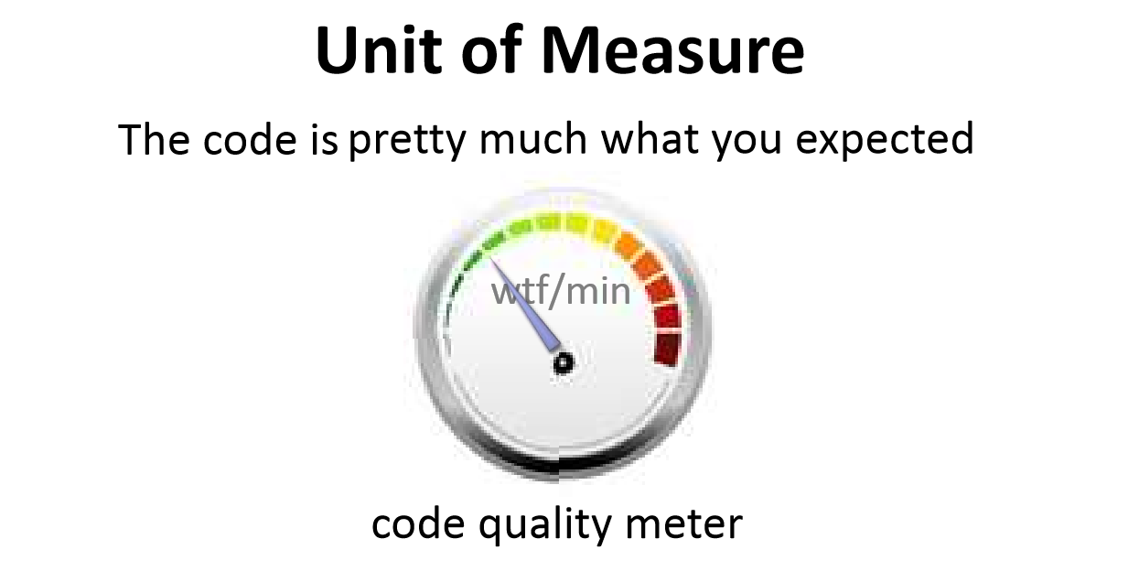

Slide 5
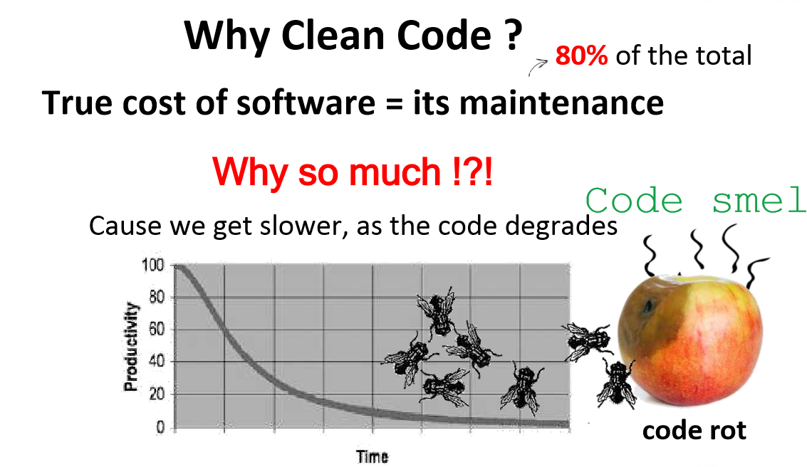

Slide 6
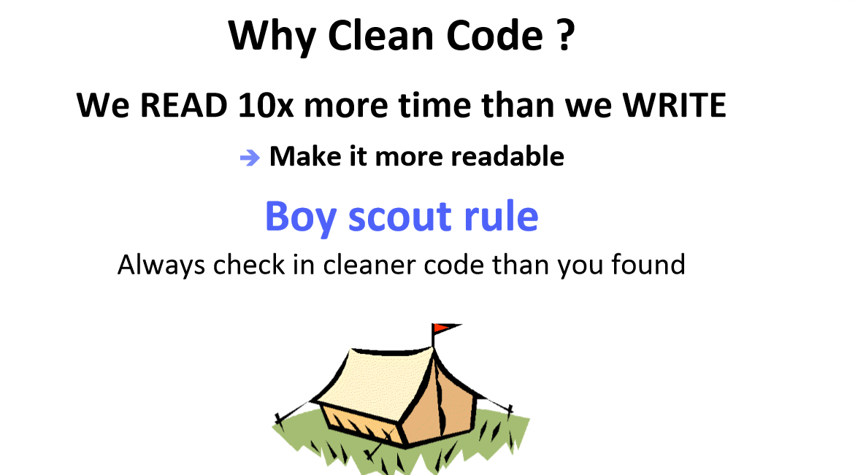

Slide 7
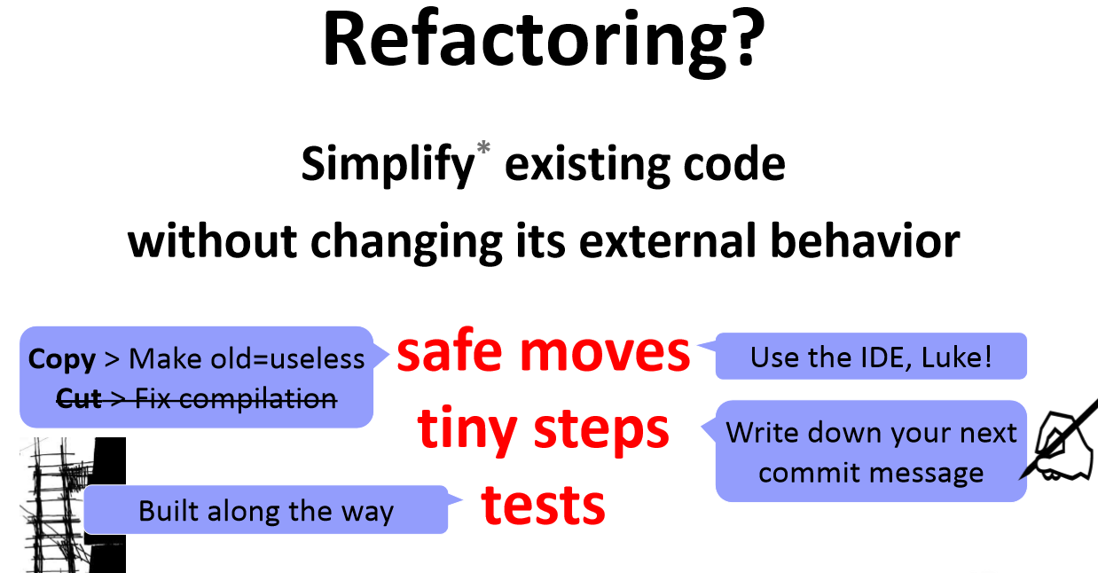

Slide 8
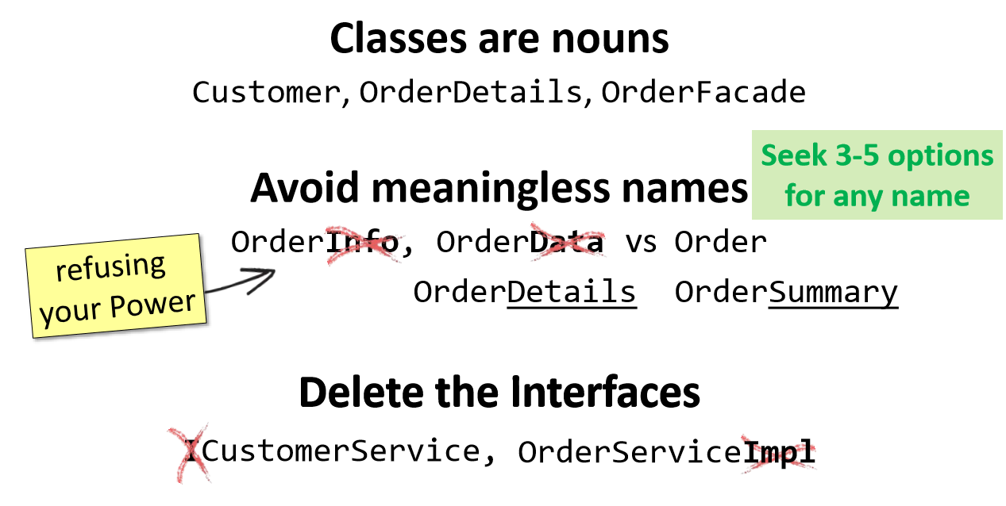

Slide 9
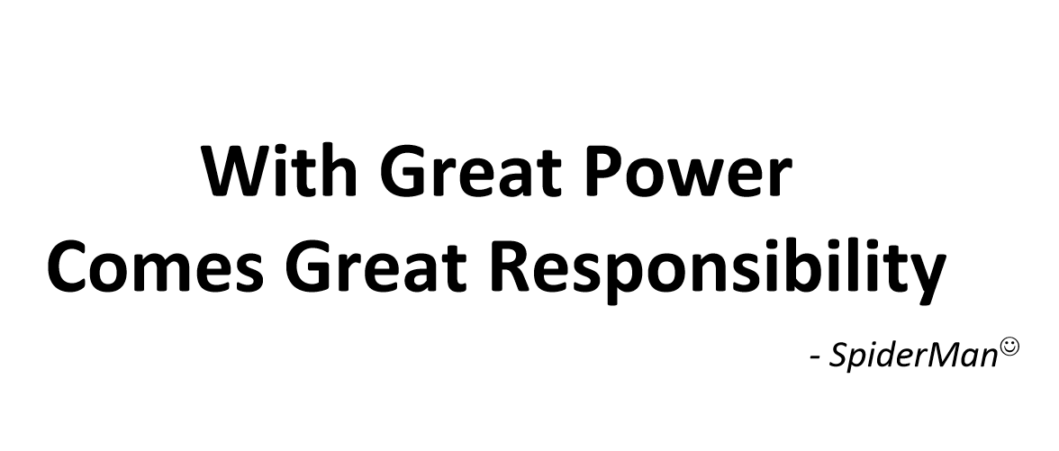
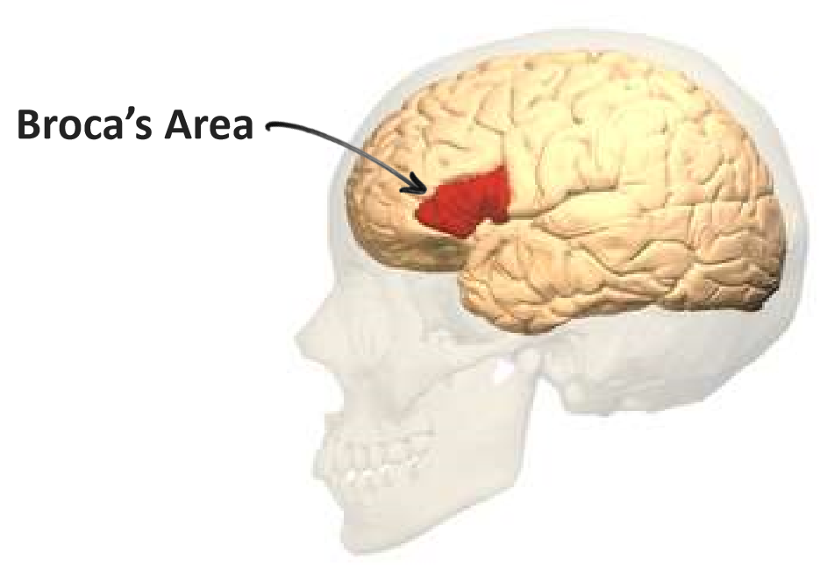

Slide 10
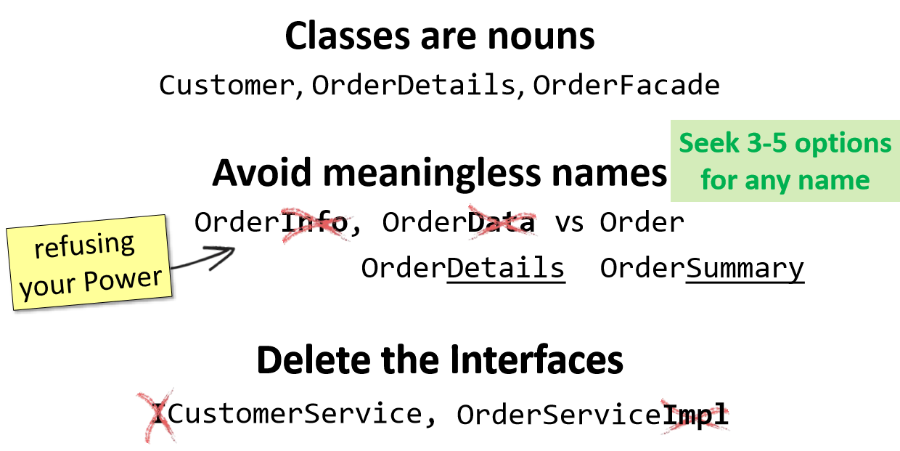

Slide 11
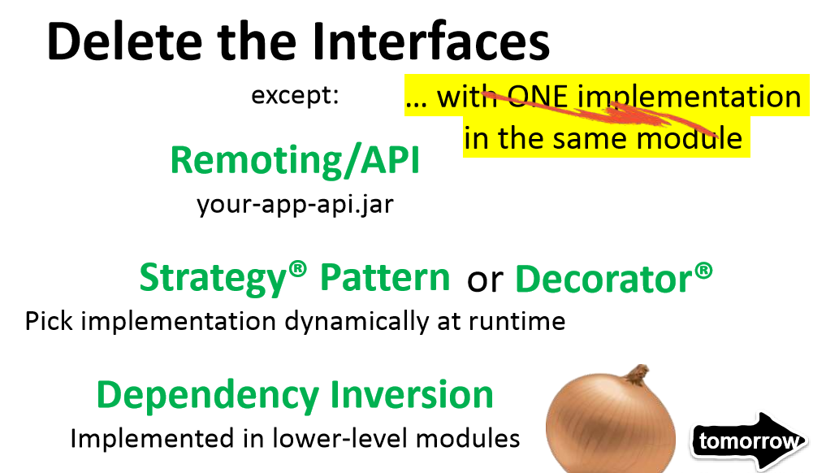

Slide 12
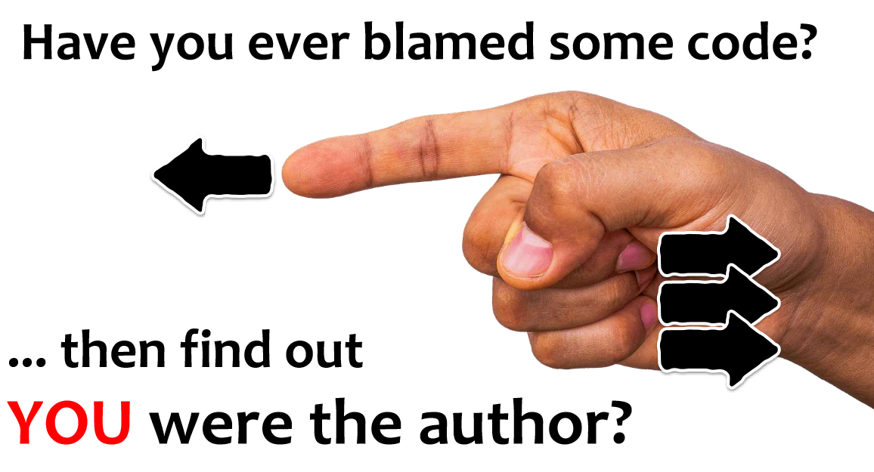

Slide 13


Slide 14
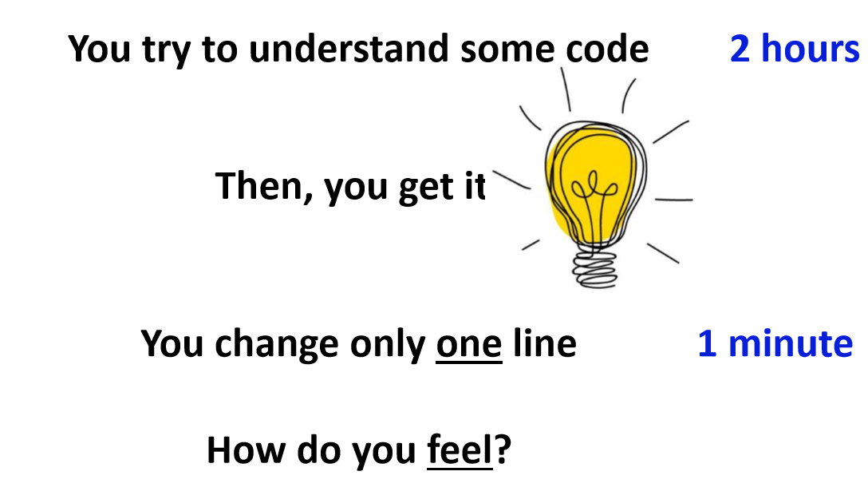

Slide 15
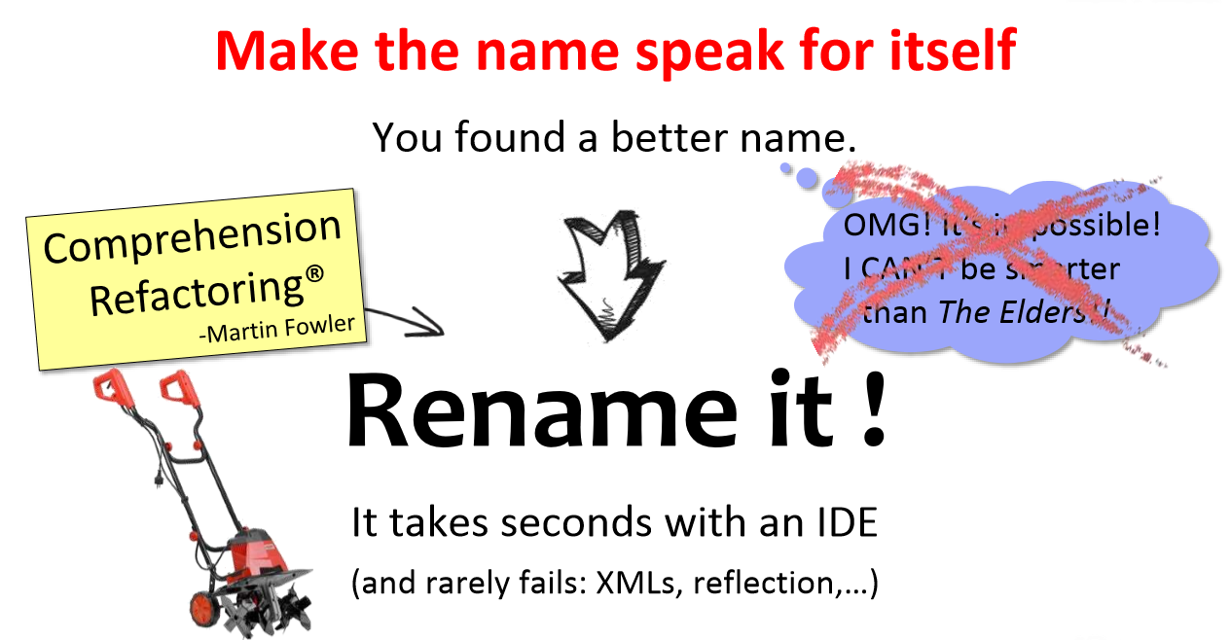

Slide 16
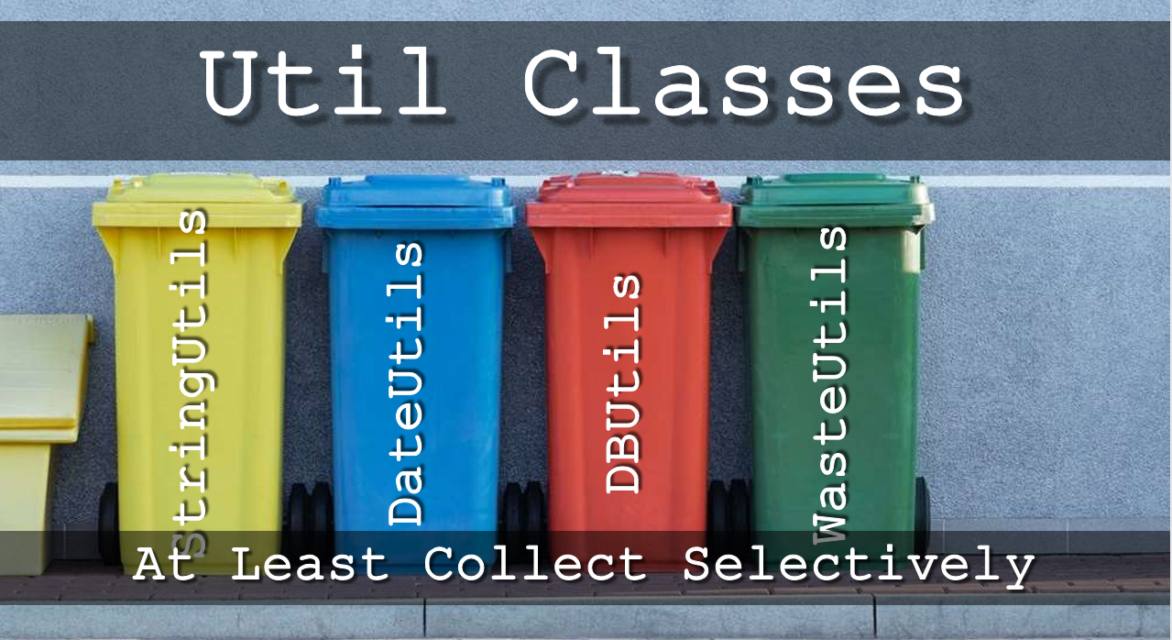

Slide 17
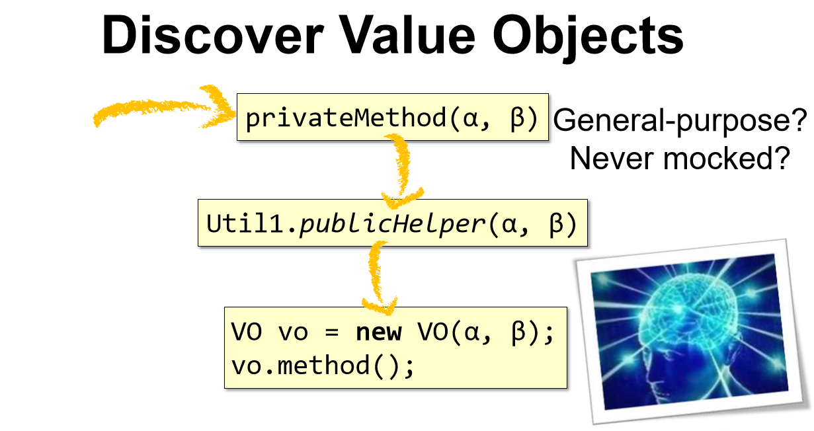

Slide 18
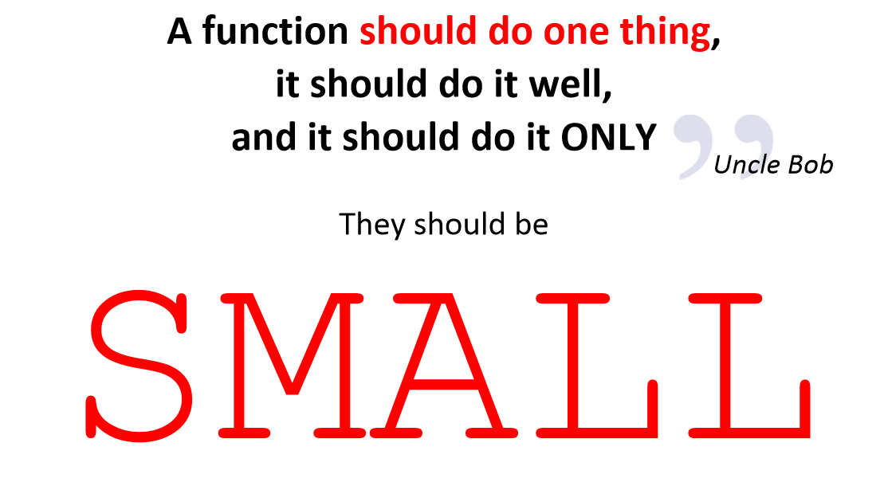

Slide 19
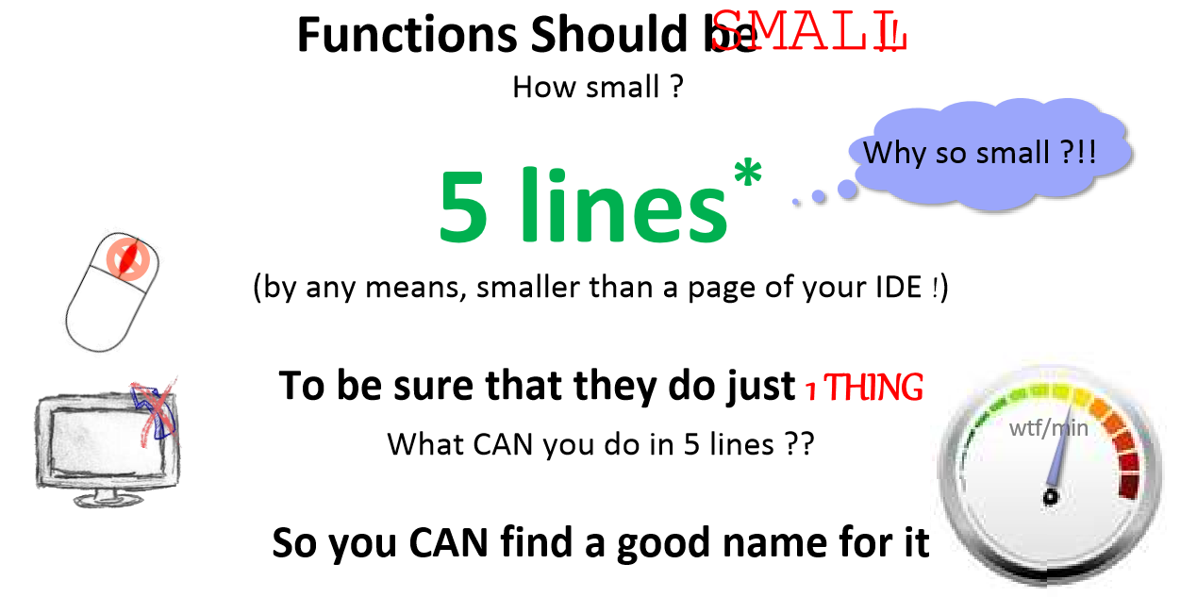

Slide 20
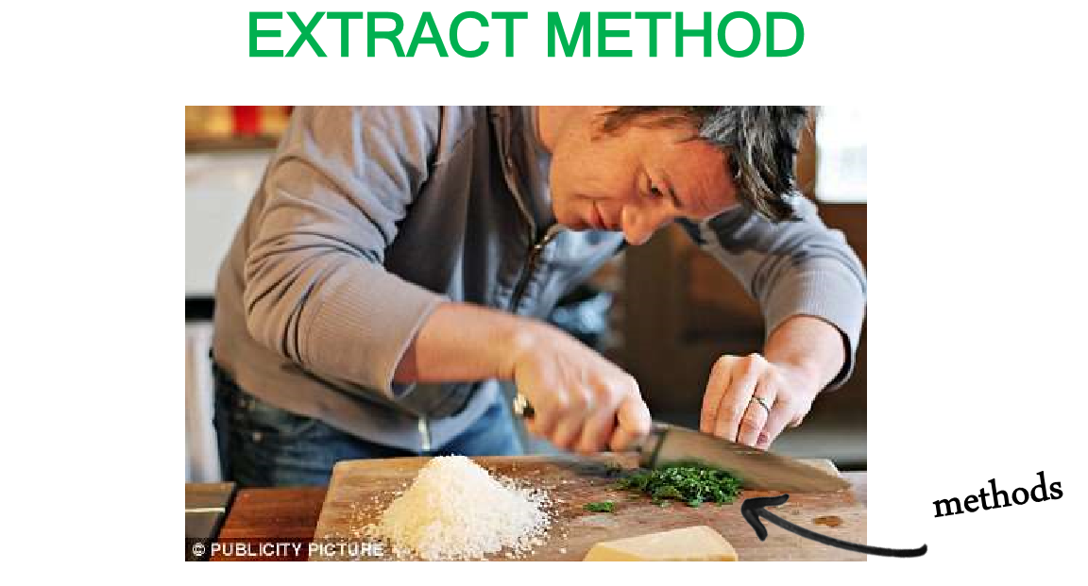

Slide 21
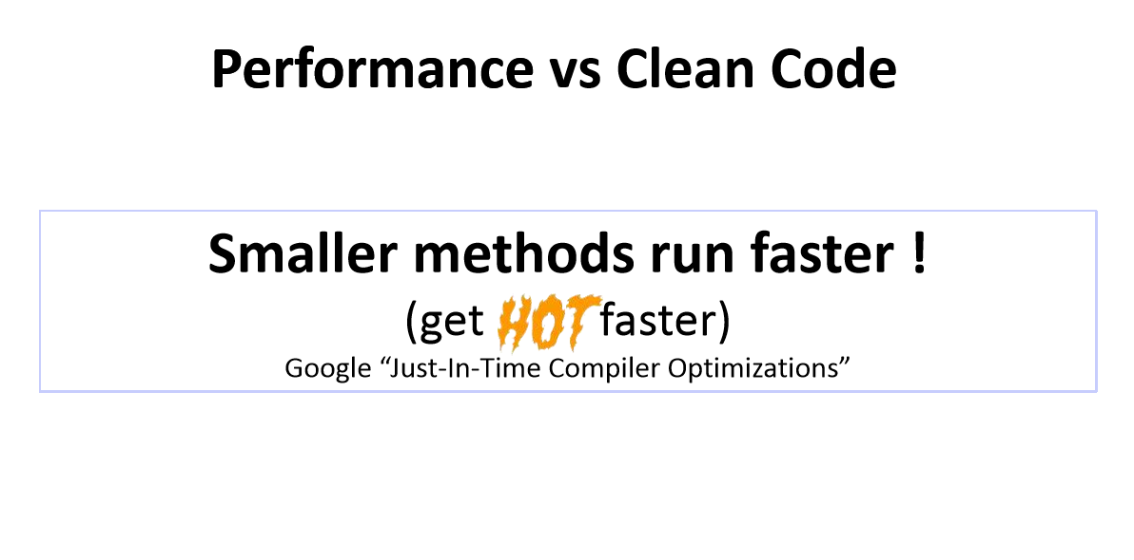

Slide 22
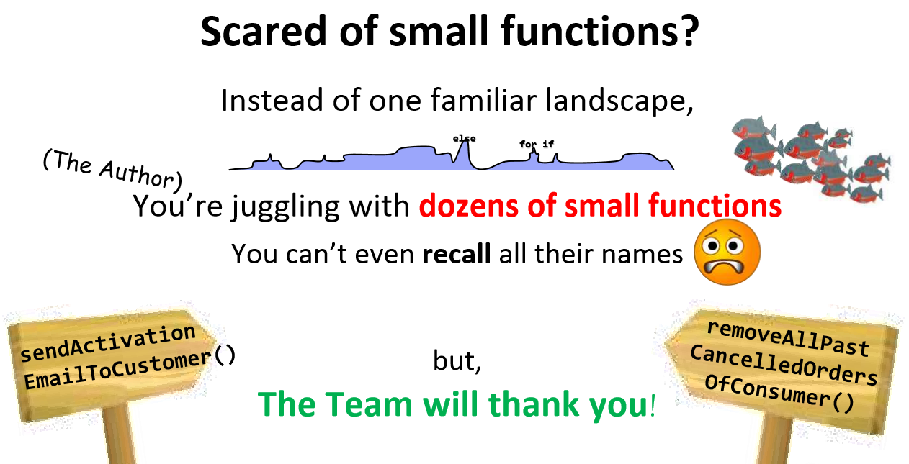

Slide 23
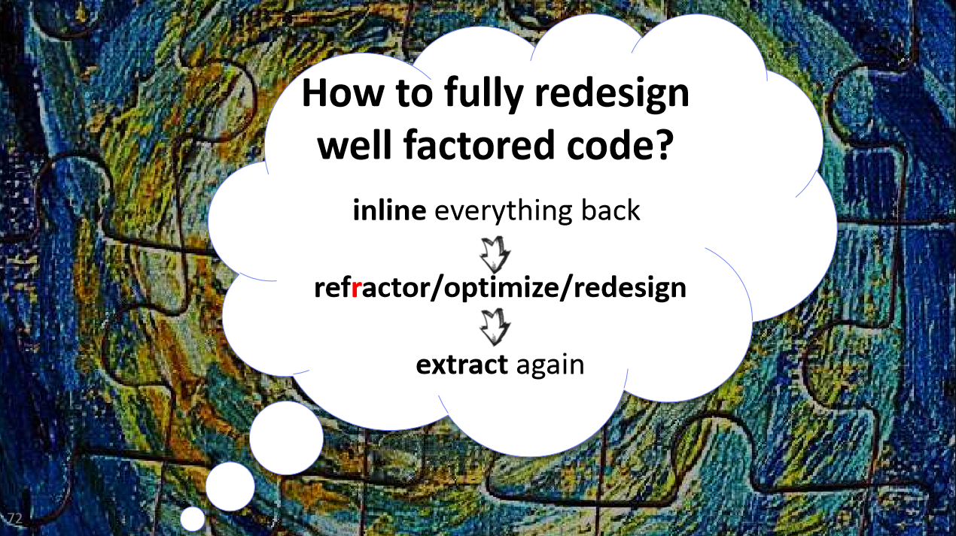

Slide 24
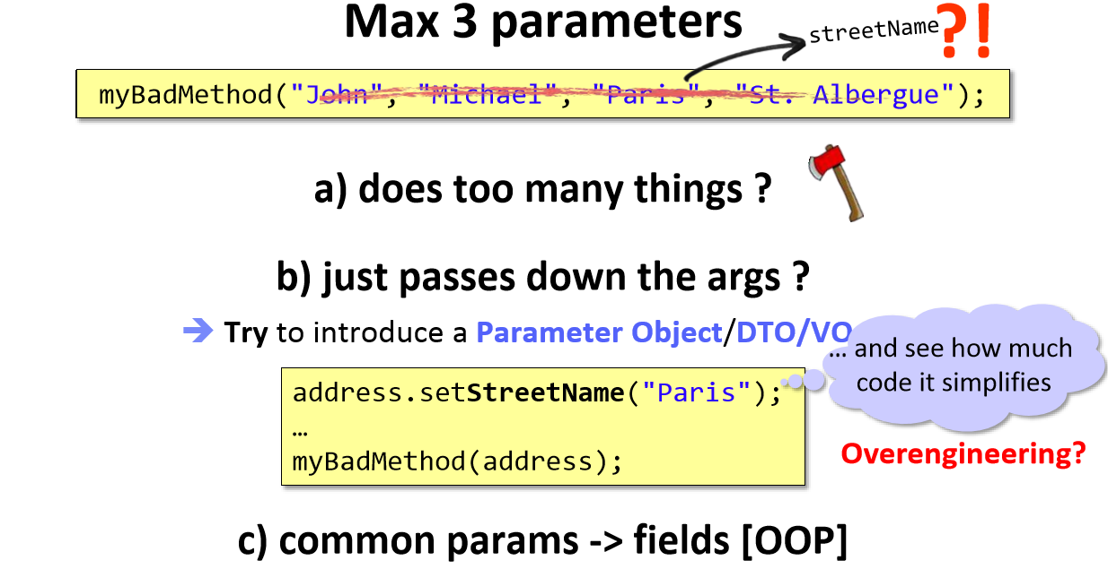

Slide 25
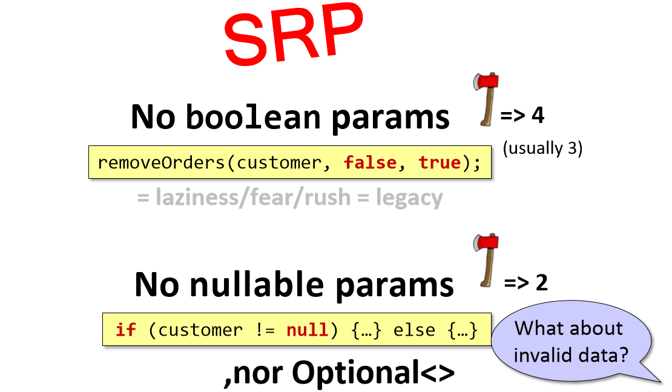

Slide 26

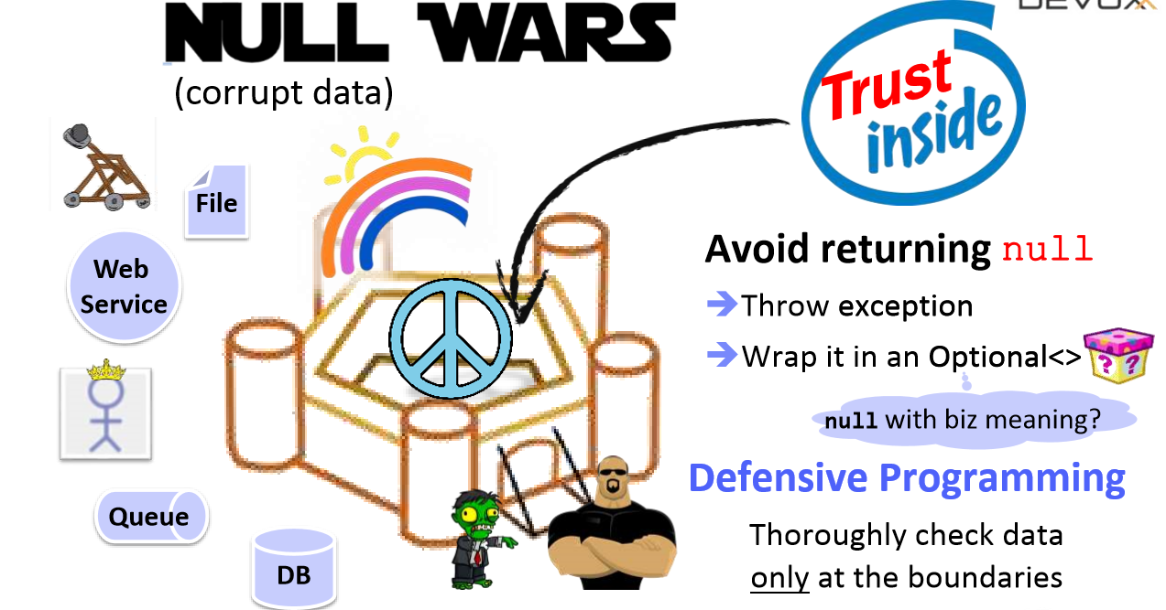

Slide 27
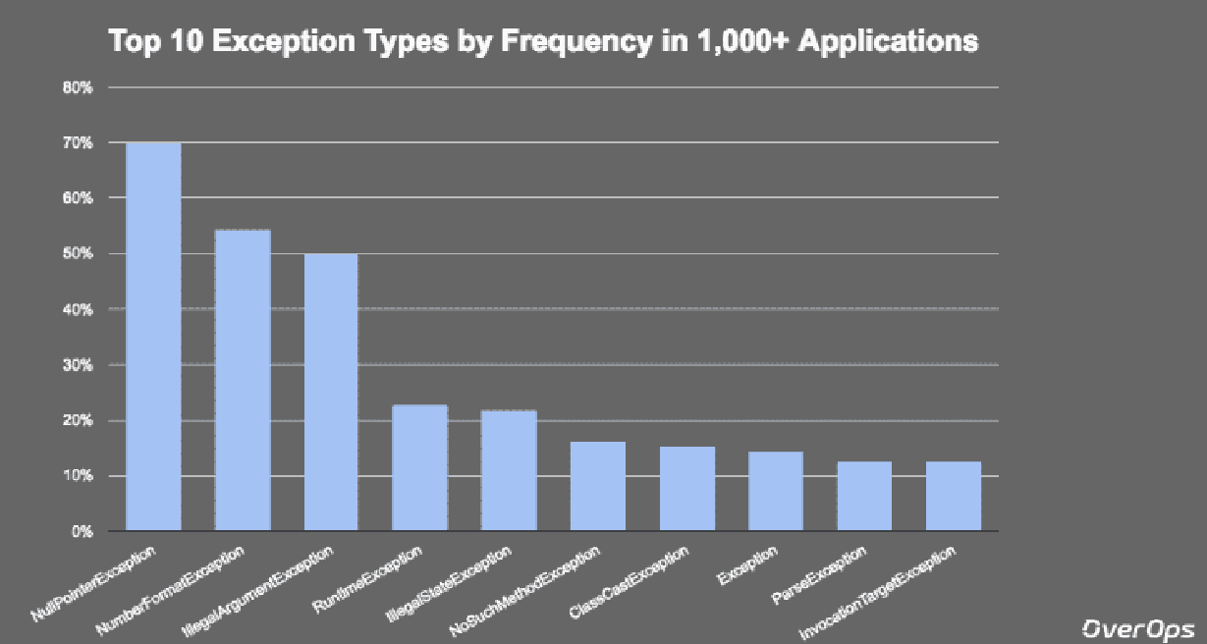

Slide 28
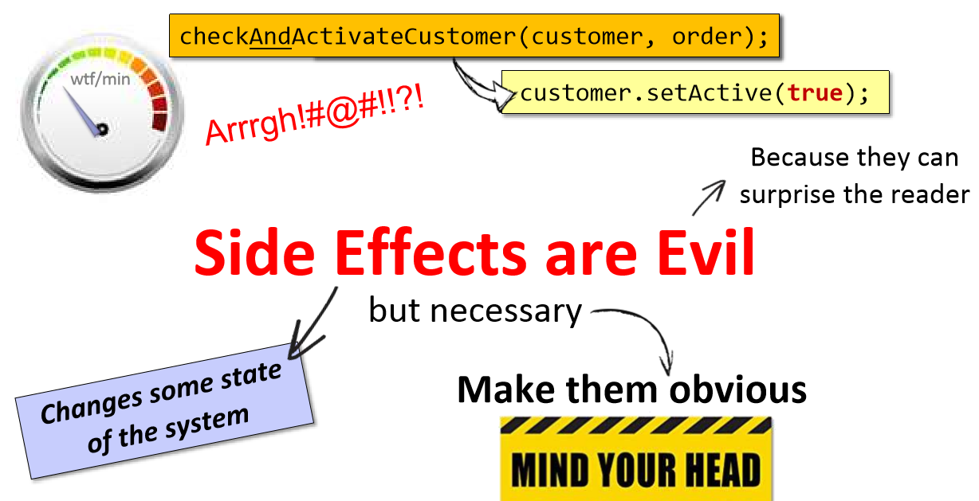

Slide 29
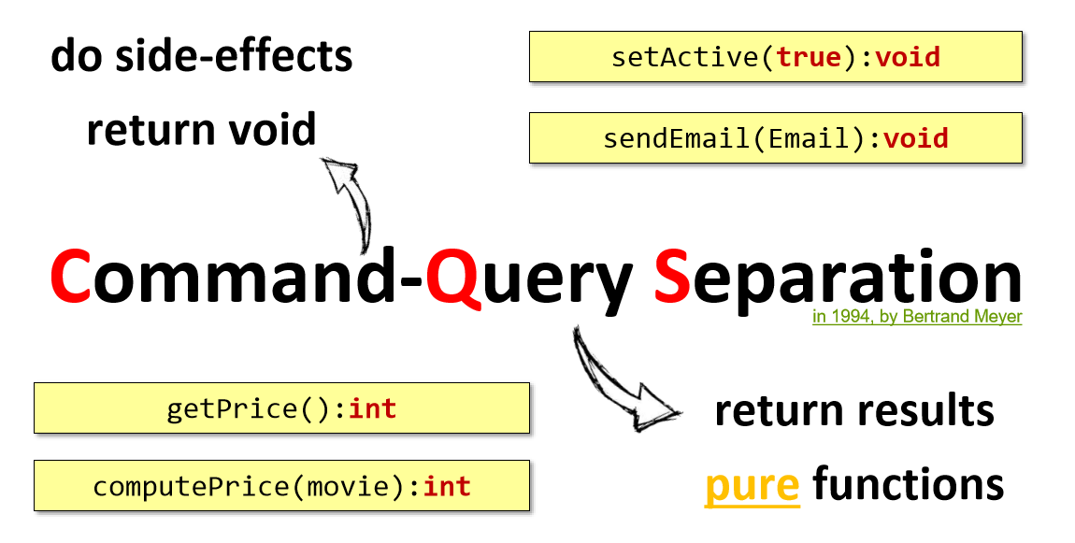

Slide 30
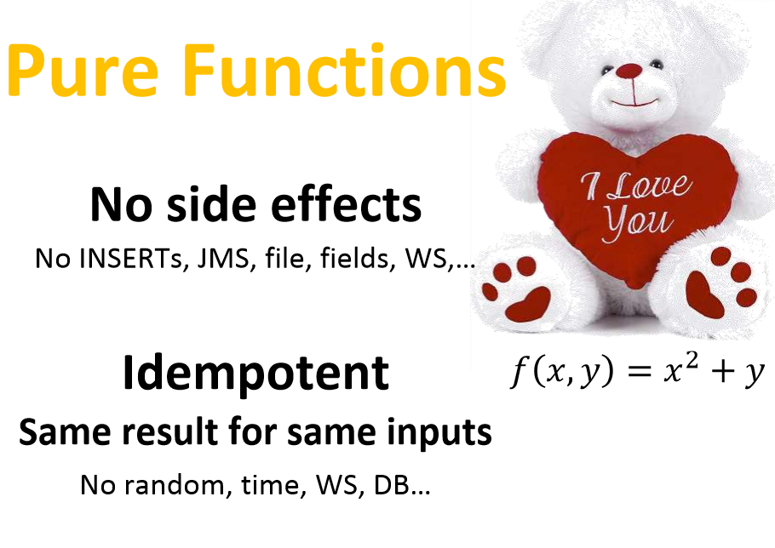

Slide 31
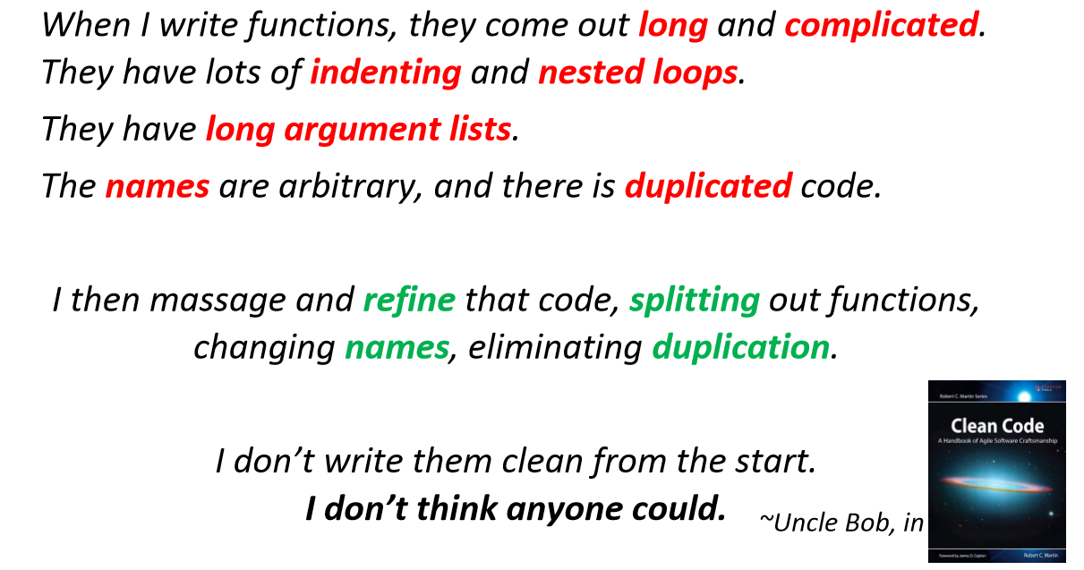

Slide 32
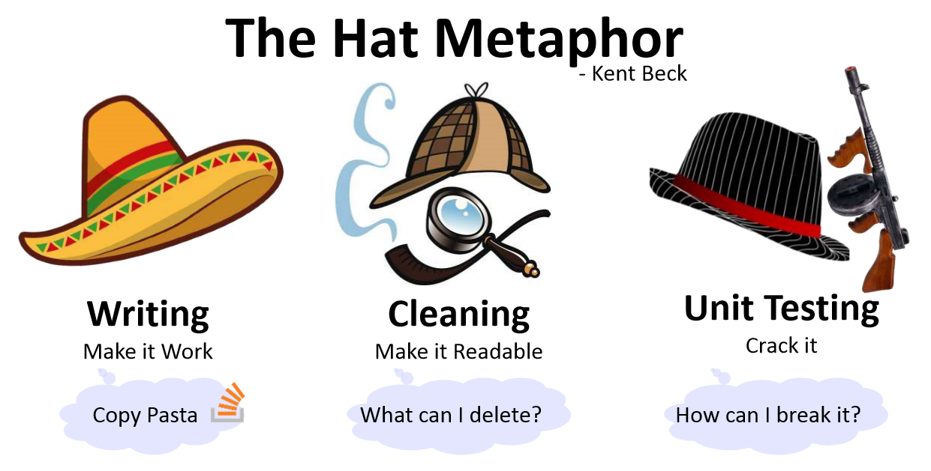

Slide 33

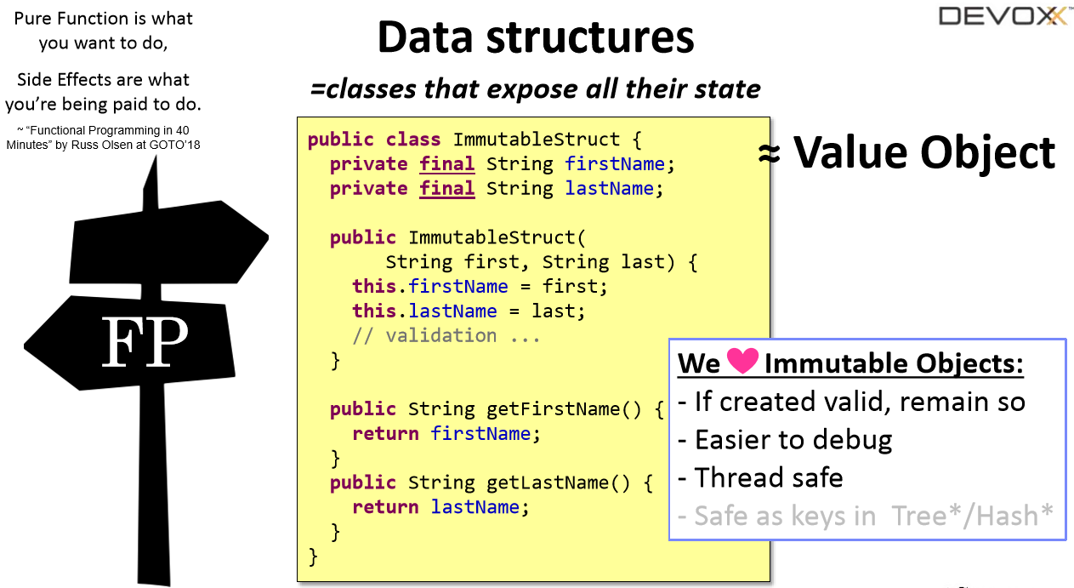

Slide 34

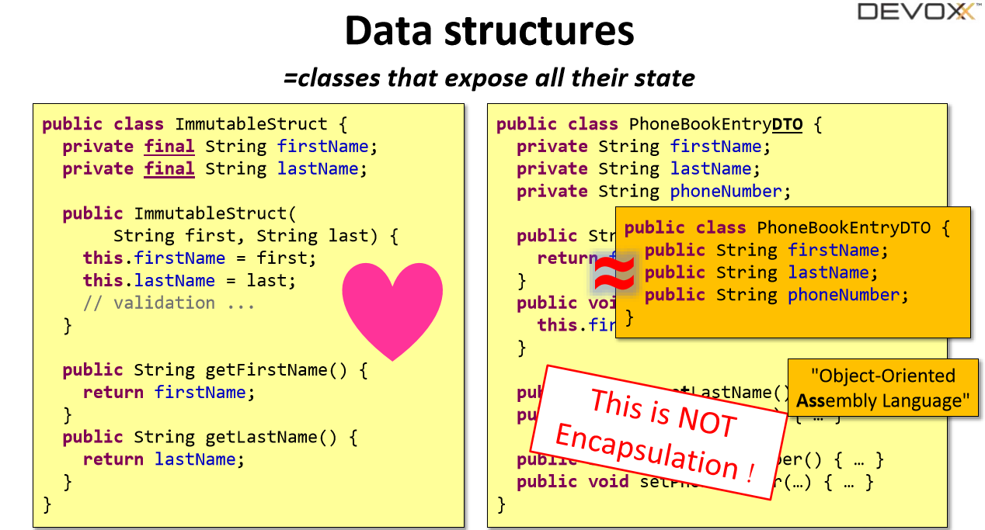

Slide 35
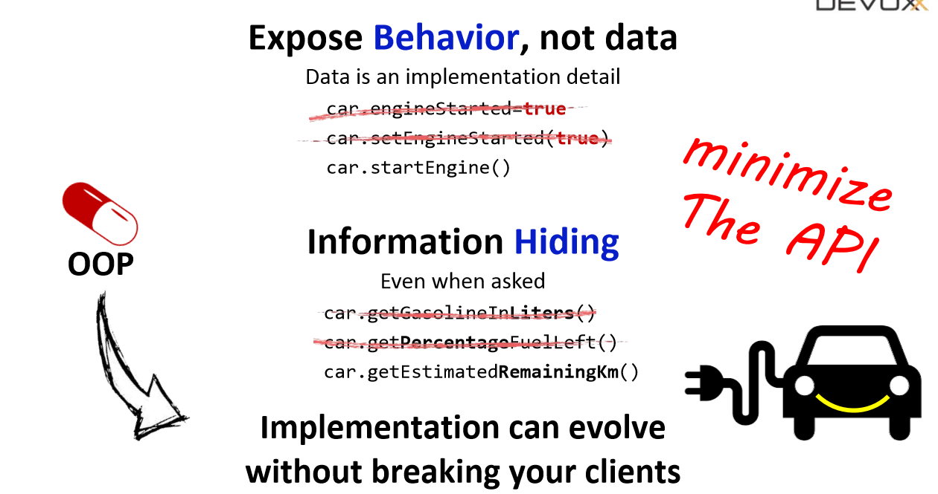


Slide 36
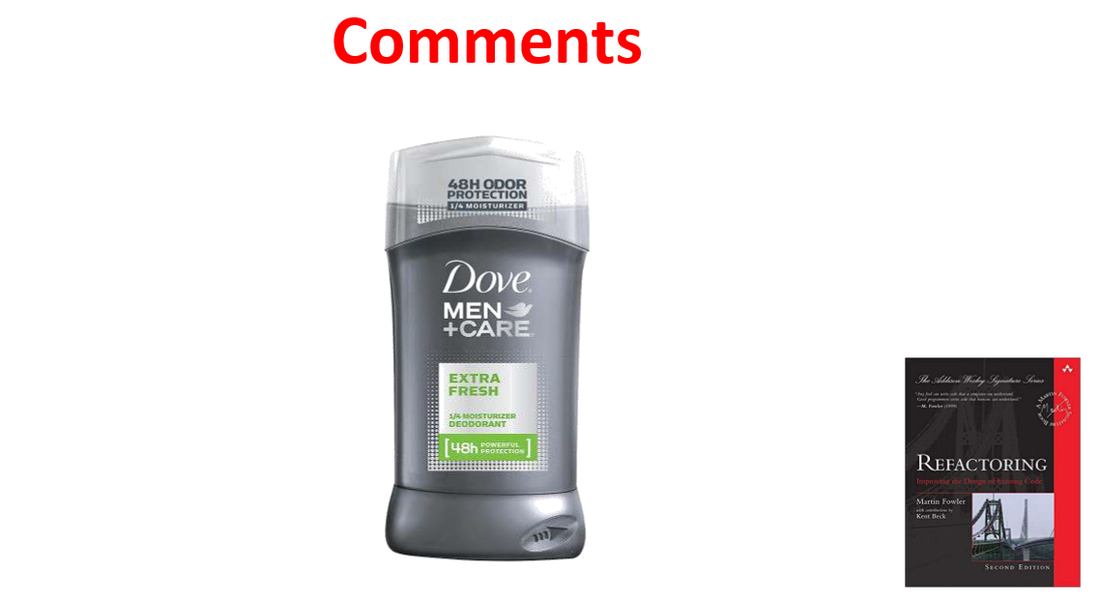

Slide 37
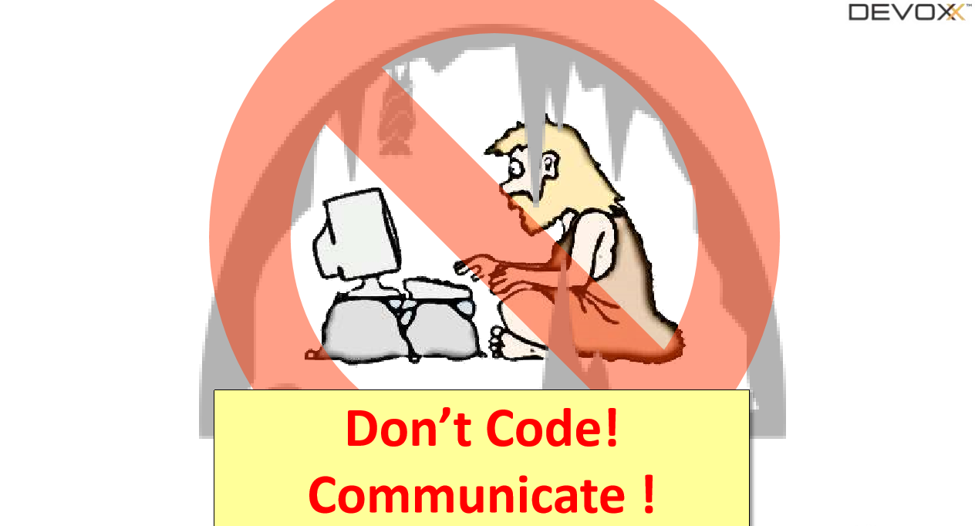

Slide 38
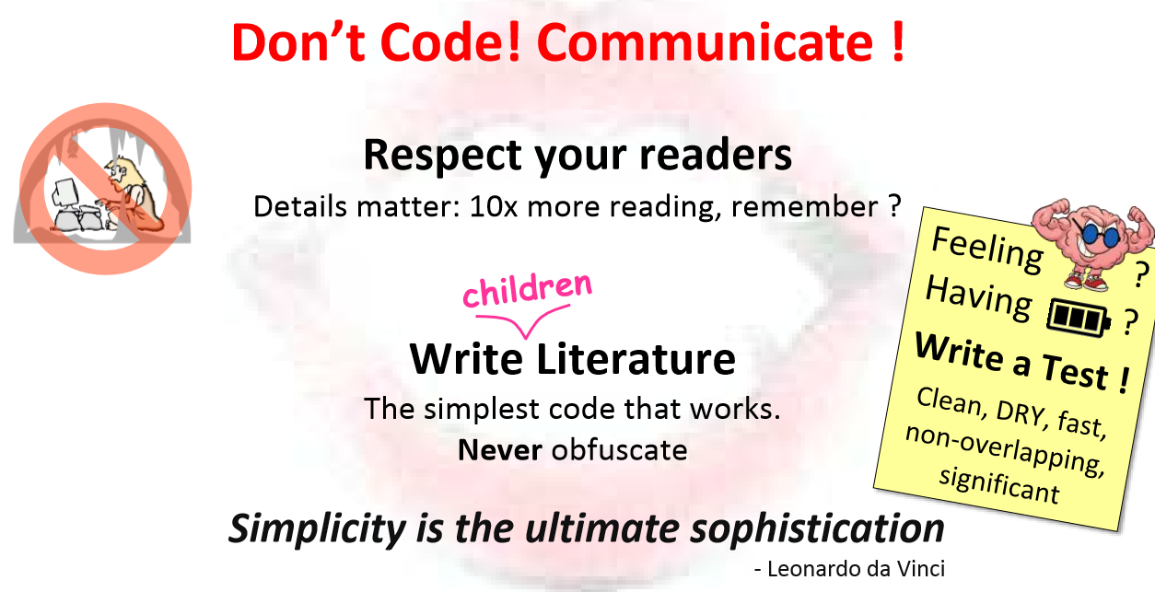

Slide 39
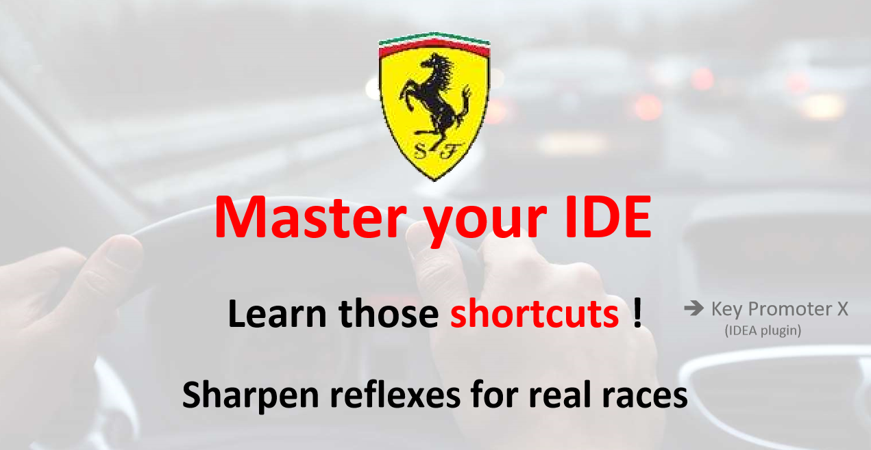

Slide 40
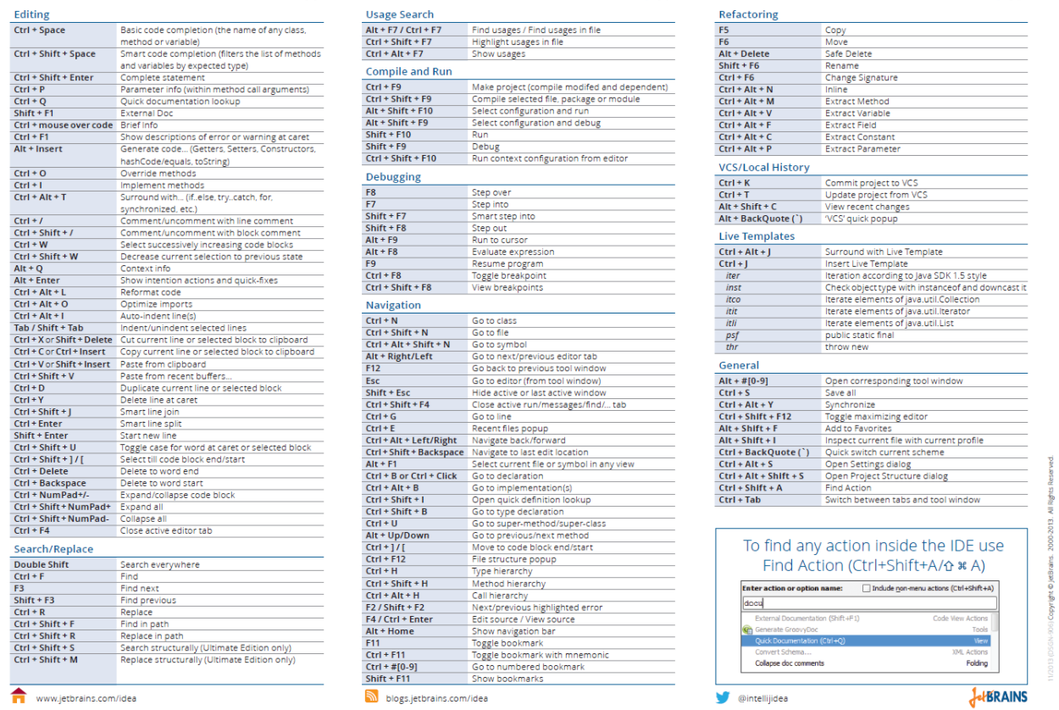

Slide 41
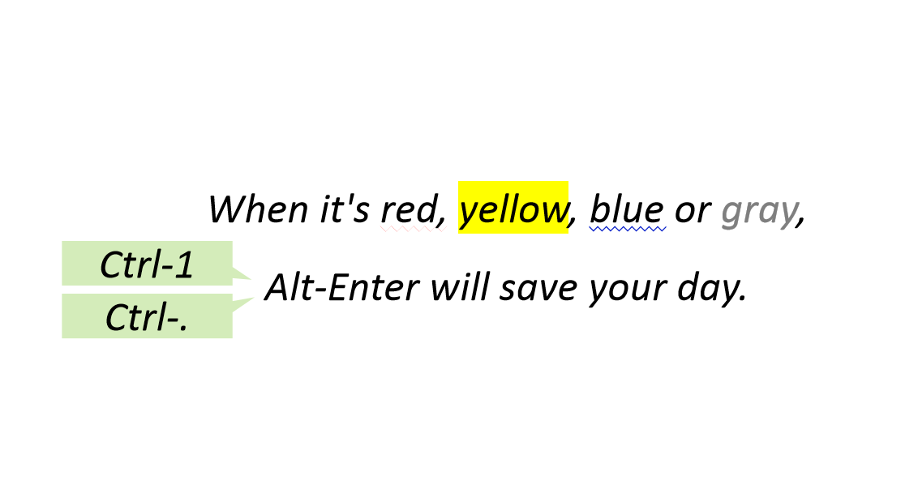

Slide 42
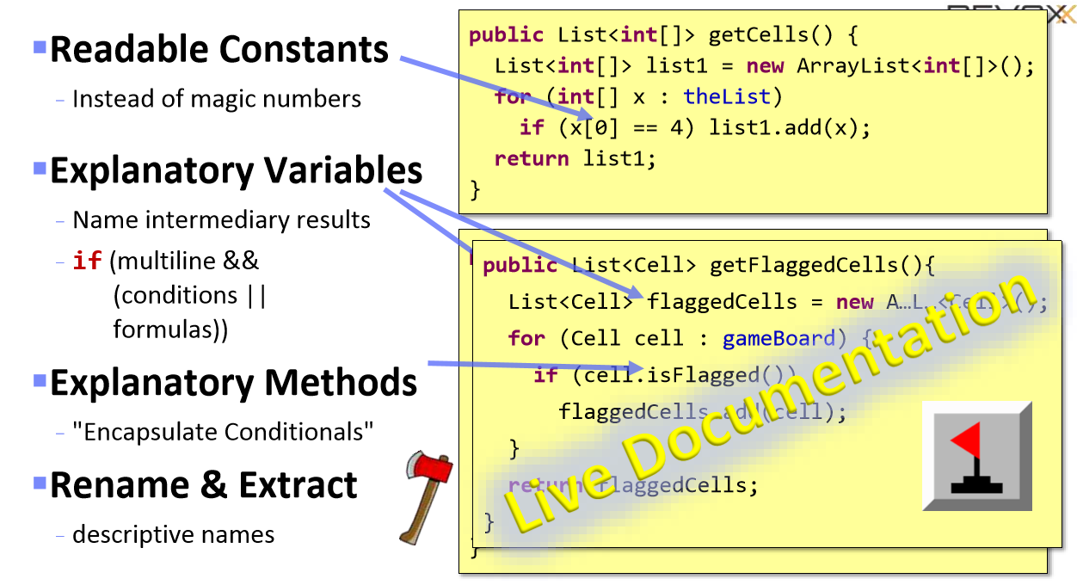

Slide 43
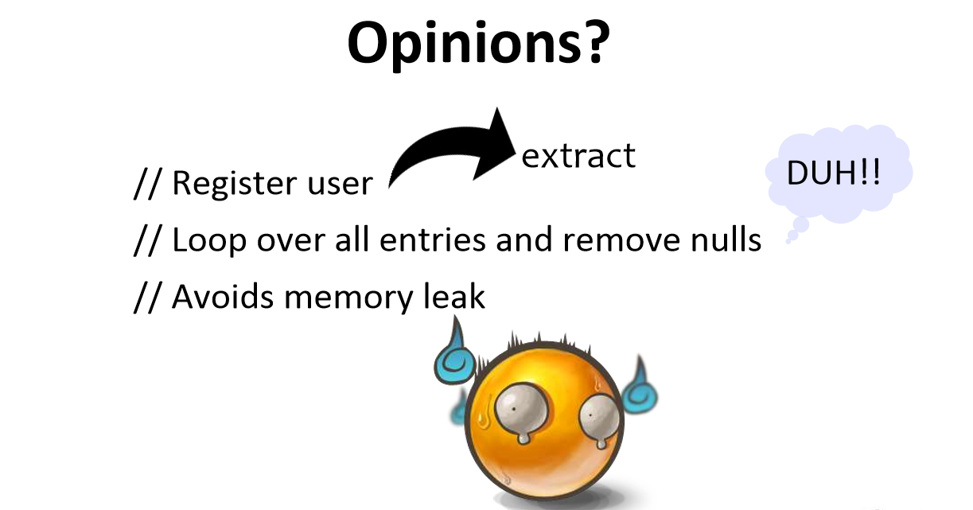

Slide 44
SOLID and Other Principles
SOLID principles:
- SRP = Single Responsibility Principle
- OCP = Open/Closed Principles
- LSP = Liskov Substitution Principle
- ISP = Interface Segregation Principle
- DIP = Dependency Inversion Principle
Other Principles:
- DRY = Don’t Repeat Yourself
- YAGNI = You Aren't Gonna Need It
- KISS = Keep It Simple, Stupid

Slide 45
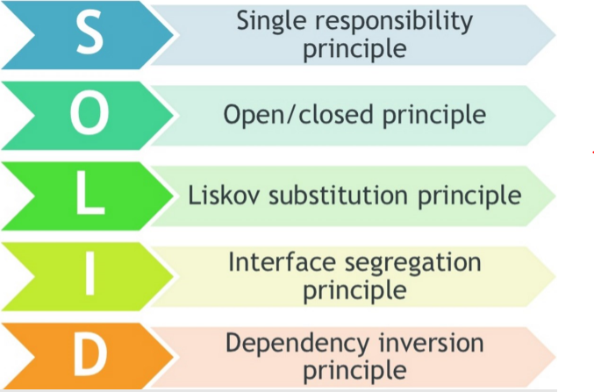
SOLID
SOLID was introduced by Robert C. Martin in the article called the “Principles of Object Oriented Design” in the early 2000s
“One class should have one and only one responsibility”

Slide 46

SOLID – SRP - Definitions
“The Single Responsibility Principle states that every object should have a single responsibility, and that responsibility should be entirely encapsulated by the class.” – Wikipedia
“There should never be more than one reason for a class to change.” - Robert Martin
Low coupling & strong cohesion

Slide 47
SOLID – SRP – Problems & Solutions
Classic violations
Classic solution
Solution
Result
Objects that can print/draw themselves
Objects that can save/restore themselves
Separate printer
Separate saver
Multiple small interfaces (ISP)
Many small classes
Distinct responsibilities
Flexible design
Lower coupling
Higher cohesion

Slide 48
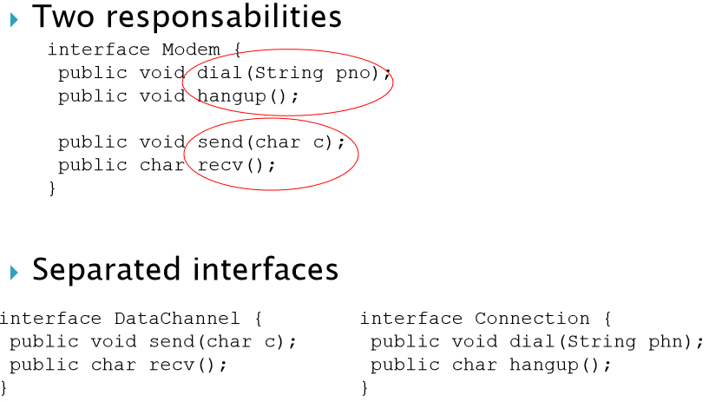
SOLID – SRP - Example

Slide 49
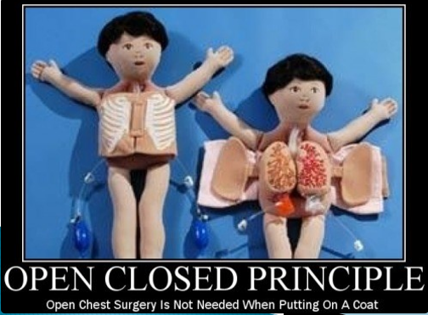
SOLID – Open/Closed Principle
Open chest surgery is not needed when putting on a coat
Bertrand Meyer originated the OCP term in his 1988 book, Object Oriented Software Construction

Slide 50
SOLID – OCP - Definitions
“The Open / Closed Principle states that software entities (classes, modules, functions, etc.) should be open for extension, but closed for modification.” – Wikipedia
“All systems change during their life cycles. This must be borne in mind when developing systems expected to last longer than the first version.” - Ivar Jacobson
Open to Extension - New behavior can be added in the future
Closed to Modification - Changes to source or binary code are not required

Slide 51
SOLID – OCP – How?
Change behavior without changing code?!
◦ Rely on abstractions, not implementations
◦ Do not limit the variety of implementations
In JAVA – Interfaces, Abstract Classes
In procedural code - Use parameters
Approaches to achieve OCP
◦ Parameters - Pass delegates / callbacks
◦ Inheritance / Template Method pattern - Child types override behavior of a base class
◦ Composition / Strategy pattern - Client code depends on abstraction, "Plug in" model

Slide 52
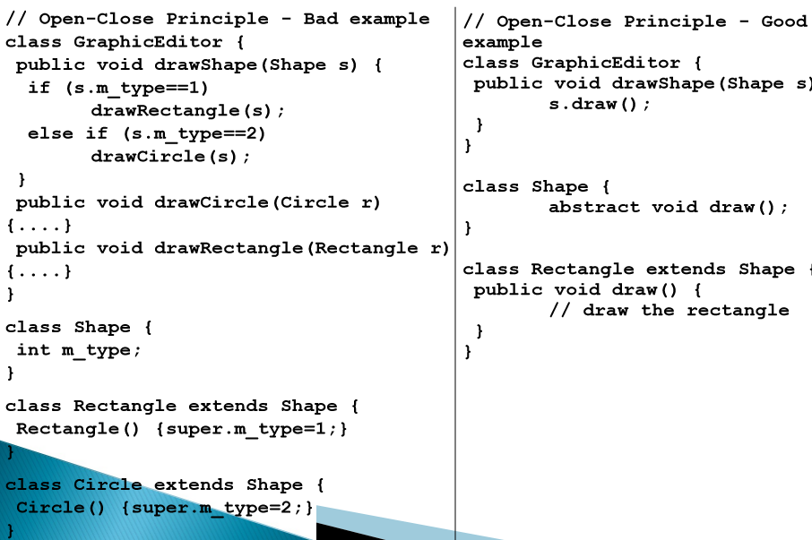
SOLID – OCP – Problems & Solutions
Classic violations
◦ Each change requires re-testing (possible bugs)
◦ Cascading changes through modules
◦ Logic depends on conditional statements
Classic solution
◦ New classes (nothing depends on them yet)
◦ New classes (no legacy coupling)
When to apply OCP?
◦ Experience tell you
OCP add complexity to design (TANSTAAFL)
No design can be closed against all changes

Slide 53
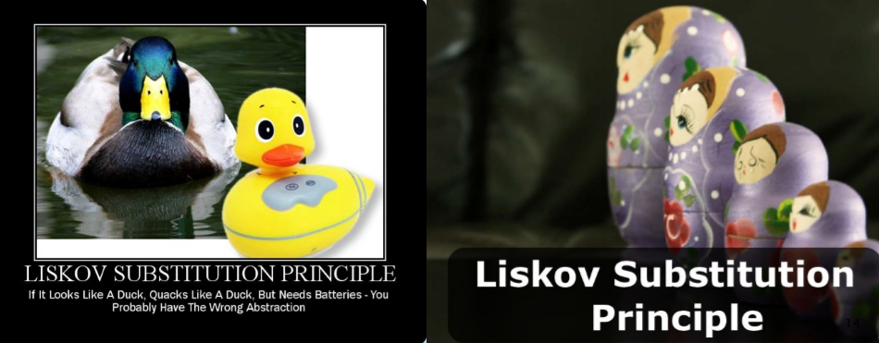
SOLID – Liskov Substitution
If it looks like a duck, quacks like a duck, but needs batteries – you probably have the wrong abstraction
Barbara Liskov described the principle in 1988

Slide 54
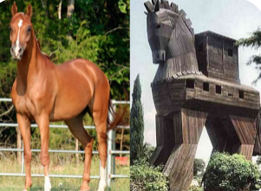
Solid – LSP - Definitions
"The Liskov Substitution Principle states that Subtypes must be substitutable for their base types.“
◦ Agile Principles, Patterns, and Practices in JAVA
Substitutability – child classes must not
◦ Remove base class behavior
◦ Violate base class invariants
Normal OOP inheritance
◦ IS-A relationship
Liskov Substitution inheritance
◦ IS-SUBSTITUTABLE-FOR

Slide 55
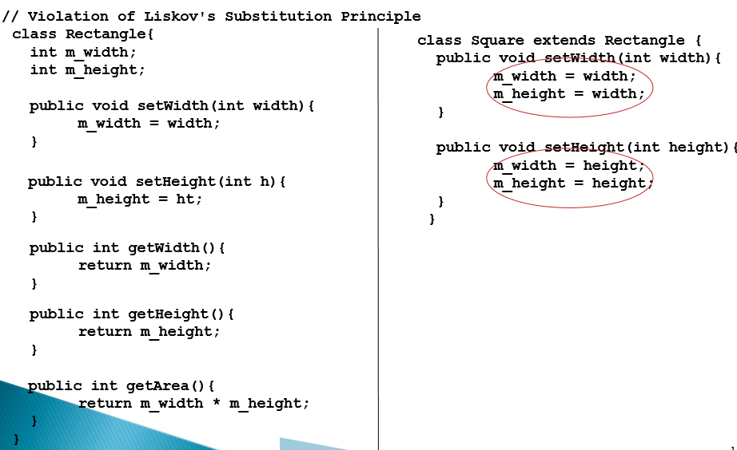
SOLID – LSP – Problems & Solutions
The problem
◦ Polymorphism break Client code expectations
◦ "Fixing" by adding if-then – nightmare (OCP)
Classic violations
◦ Type checking for different methods
◦ Not implemented overridden methods
◦ Virtual methods in constructor
Solutions
◦ “Tell, Don’t Ask” - Don’t ask for types and Tell the object what to do
◦ Refactoring to base class- Common functionality and Introduce third class

Slide 56
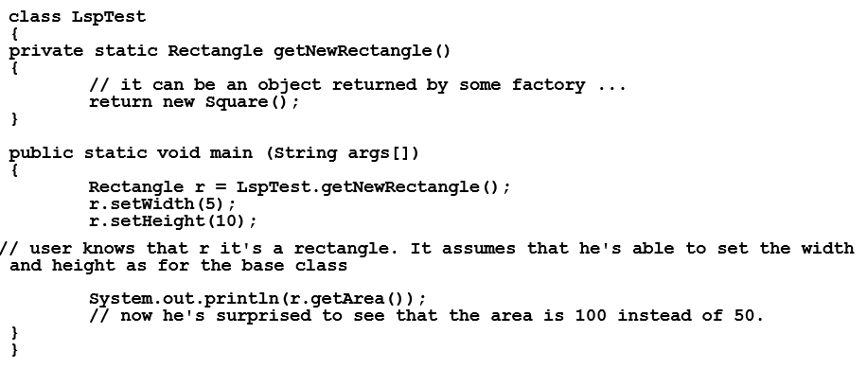
SOLID – LSP - Example

Slide 57
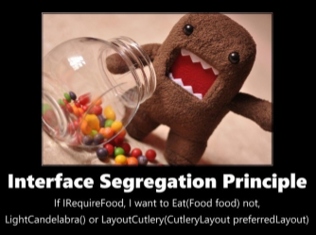


SOLID – Interface Segregation Principle
You want me to plug this in. Where?

Slide 58

SOLID – ISP - Definitions
“The Interface Segregation Principle states that
- Clients should not be forced to depend on methods they do not use.” - Agile Principles, Patterns, and Practices in JAVA
Prefer small, cohesive interfaces
- Interface is the interface type + All public members of a class
Divide "fat" interfaces into smaller ones
- “fat” interfaces means classes with useless methods, increased coupling, reduced flexibility and maintainability

Slide 59
SOLID – ISP – Problems & Solutions
Classic violations
◦ Unimplemented methods (also in LSP)
◦ Use of only small portion of a class
When to fix?
◦ Once there is pain! Do not fix, if is not broken!
◦ If the "fat" interface is yours, separate it to smaller ones
◦ If the "fat" interface is not yours, use "Adapter" pattern
Solutions
◦ Small interfaces
◦ Cohesive interfaces
◦ Focused interfaces
◦ Let the client define interfaces
◦ Package interfaces with their implementation

Slide 60


Slide 61

SOLID – Dependency Inversion Principle
Would you solder a lamp directly to the electrical wiring in a wall?

Slide 62
SOLID – DIP
Definitions
DEPENDENCY
“High-level modules should not depend on low-level modules. Both should depend on abstractions.”
“Abstractions should not depend on details. Details should depend on abstractions.” Agile Principles, Patterns, and Practices in JAVA
Framework
Third Party Libraries
Database
File System
Email
Web Services
System Resources
Configuration
The new Keyword
Static methods
Thread.Sleep
Random

Slide 63
SOLID – DIP – Problems & Solutions
How it should be
◦ Classes should declare what they need
◦ Constructors should require dependencies
◦ Dependencies should be abstractions and be shown
How to do it
◦ Dependency Injection
◦ The Hollywood principle "Don't call us, we'll call you!"
Classic violations
◦ Using of the new keyword, static methods/properties
How to fix?
◦ Default constructor, main method/starting point
◦ Inversion of Control container

Slide 64


Slide 65
Other Principles
- Don't Repeat Yourself (DRY)
- You Ain't Gonna Need It (YAGNI)
- Keep It Simple, Stupid (KISS)

Slide 66

OP – Don’t Repeat Yourself
Repetition is the root of all software evil!!!
"Every piece of knowledge must have a single, unambiguous representation in the system.“ (The Pragmatic Programmer)
"Repetition in logic calls for abstraction. Repetition in process calls for automation.“ (97 Things Every Programmer Should Know)\
Once and Only Once
Duplication Is Evil (DIE)

Slide 67
OP – DRY - Problems
Magic Strings/Values
Duplicate logic in multiple locations
Repeated if-then logic
Conditionals instead of polymorphism
Repeated Execution Patterns
Lots of duplicate, probably copy-pasted, code
Only manual tests
Static methods everywhere

Slide 68

OP – You Ain’t Gonna Need It
Don’t waste resources on what you might need!!!

Slide 69
OP – YAGNI
Definitions
Problems
"A programmer should not add functionality until deemed necessary.“ – Wikipedia
"Always implement things when you actually need them, never when you just foresee that you need them.“ - Ron Jeffries, XP co-founder
Time for adding, testing, improving
Debugging, documented, supported
Difficult for requirements
Larger and complicate software
May lead to adding even more features
May be not know to clients

Slide 70

OP – KISS – Definitions
You don’t need to know the entire universe when living on the Earth
"Most systems work best if they are kept simple.“ - U.S. Navy
"Simplicity should be a key goal in design and unnecessary complexity should be avoided.“ - Wikipedia

Slide 71


Slide 72


Slide 73


Slide 74


Slide 75


Slide 76


Slide 77


Slide 78


Slide 79



Slide 80


Slide 81


Slide 82


